Slide 1
Stock Bottom Analysis
By: Akhil Akula

Slide 2
Current Events/Statistics
Stock Market
COVID-19
February 20, 2020:
S&P 500 → 3,400
DOW → 29,200
NASDAQ → 9,800
March 23, 2020:
S&P 500 → 2,200
DOW → 18,600
NASDAQ → 6,900
Present Day: March 31, 2020:
S&P 500 → 2,600
DOW → 22,400
NASDAQ → 7,900
February 20,2020:
Global Cases → 76,677
Global Deaths → 2,247
US Cases → 15
US Deaths → 0
March 23, 2020:
Global Cases → 378,830
Global Deaths → 16,513
US Cases → 43,781
US Deaths → 555
Present Day: March 31, 2020:
Global Cases → 803,313
Global Deaths → 39,014
US Cases → 165,594
US Deaths → 3,180

Slide 3
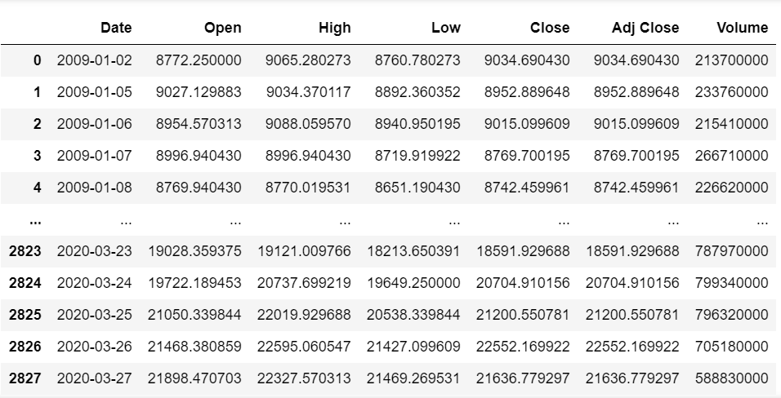
DOW

Slide 4
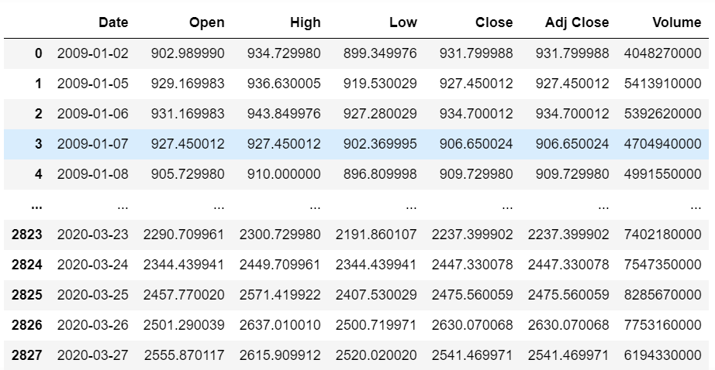
S&P 500

Slide 5
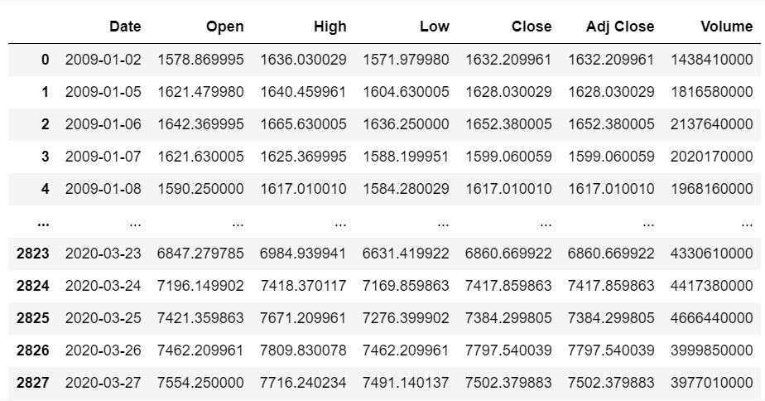
NASDAQ

Slide 6
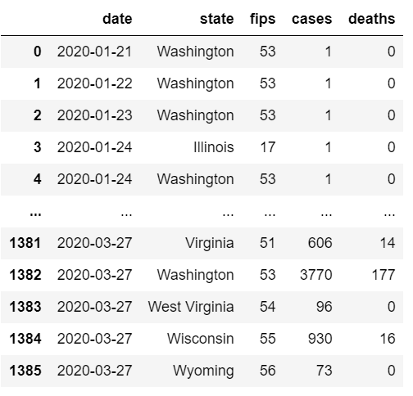
COVID-19

Slide 7
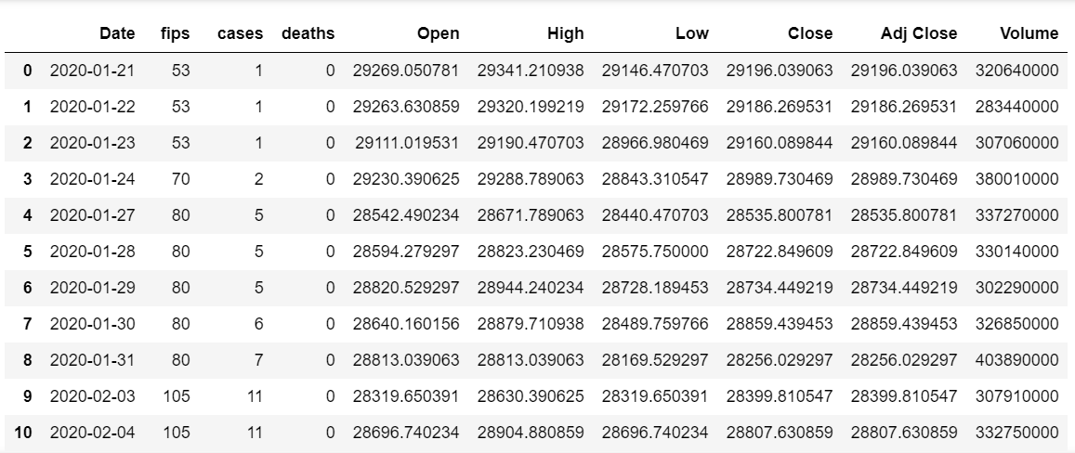
COVID19_DJI

Slide 8
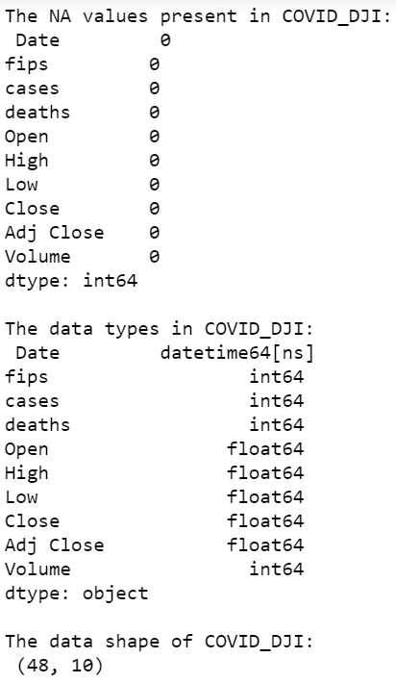
COVID19_DJI

Slide 9
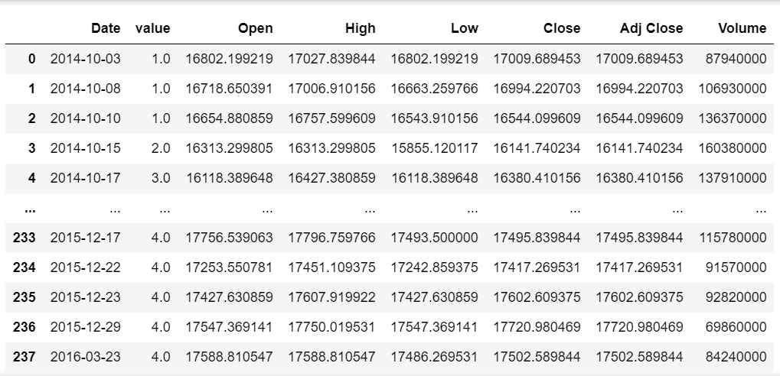
Ebola_DJI

Slide 10
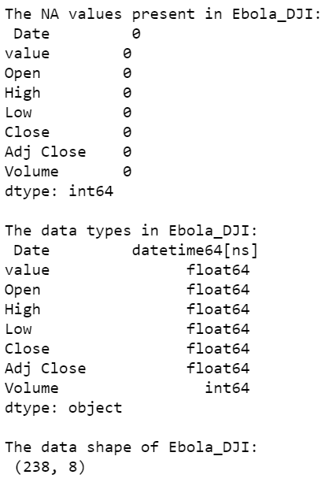
Ebola_DJI

Slide 11
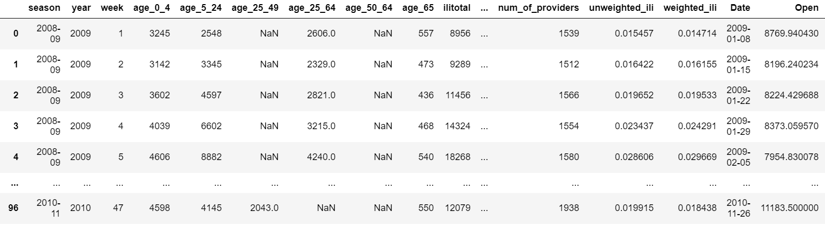
Swine_DJI

Slide 12
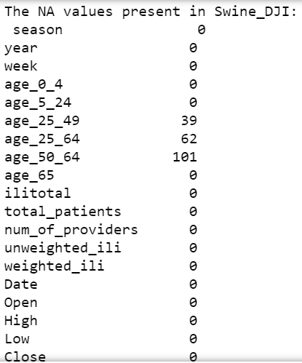
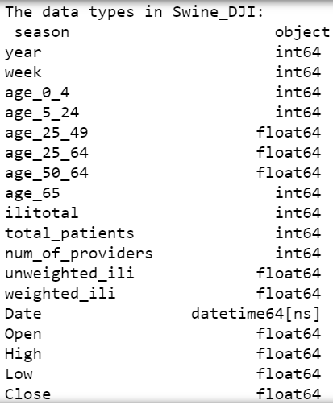

Swine_DJI

Slide 13
Problem Statement
Over the span of 12 years we came out of a financial recession, brought unemployment to record lows, and showed us a record setting bull market
We saw the highest values of stocks in the past 4 years
We lost the work of 4 years in 1 month
Everyone is saying the reason for the crash is COVID-19, but when we saw the greatest increase in cases and deaths, the market seemed to bounce back

Slide 14
Problem Statement
Have we seen the bottom of the bear market?
How have past pandemics affected the stock market?
Can we predict how the market will be affected going into the future?
How long until we see the market bounce back?
What can we expect for the future?

Slide 15
Packages Used/Using
Pandas
Numpy
Datetime
Seaborn
Matplotlib
Sckitlearn
Tensorflow
Xgboost

